Slide 1

Electronic mails
Introuction to electronic mails

Slide 2
Electronic mail, commonly known as email, is a method of exchanging messages over the internet. Here are the basics of email:
An email address: This is a unique identifier for each user, typically in the format of name@domain.com.
An email client: This is a software program used to send, receive and manage emails, such as Gmail, Outlook, or Apple Mail.
An email server: This is a computer system responsible for storing and forwarding emails to their intended recipients.

Slide 3
Electronic Mail (e-mail) is one of most widely used services of Internet. This service allows an Internet user to send a message in formatted manner (mail) to the other Internet user in any part of world. Message in mail not only contain text, but it also contains images, audio and videos data. The person who is sending mail is called sender and person who receives mail is called recipient. It is just like postal mail service. Components of E-Mail System : The basic components of an email system are : User Agent (UA), Message Transfer Agent (MTA), Mail Box, and Spool file. These are explained as following below.
User Agent (UA) : The UA is normally a program which is used to send and receive mail. Sometimes, it is called as mail reader. It accepts variety of commands for composing, receiving and replying to messages as well as for manipulation of the mailboxes.
Message Transfer Agent (MTA) : MTA is actually responsible for transfer of mail from one system to another. To send a mail, a system must have client MTA and system MTA. It transfer mail to mailboxes of recipients if they are connected in the same machine. It delivers mail to peer MTA if destination mailbox is in another machine. The delivery from one MTA to another MTA is done by Simple Mail Transfer Protocol.

Slide 4
Mailbox : It is a file on local hard drive to collect mails. Delivered mails are present in this file. The user can read it delete it according to his/her requirement. To use e-mail system each user must have a mailbox . Access to mailbox is only to owner of mailbox.
Spool file : This file contains mails that are to be sent. User agent appends outgoing mails in this file using SMTP. MTA extracts pending mail from spool file for their delivery. E-mail allows one name, an alias, to represent several different e-mail addresses. It is known as mailing list, Whenever user have to sent a message, system checks recipient’s name against alias database. If mailing list is present for defined alias, separate messages, one for each entry in the list, must be prepared and handed to MTA. If for defined alias, there is no such mailing list is present, name itself becomes naming address and a single message is delivered to mail transfer entity.

Slide 6
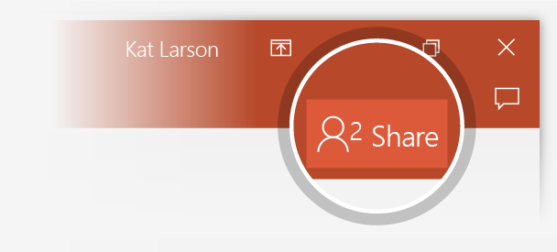
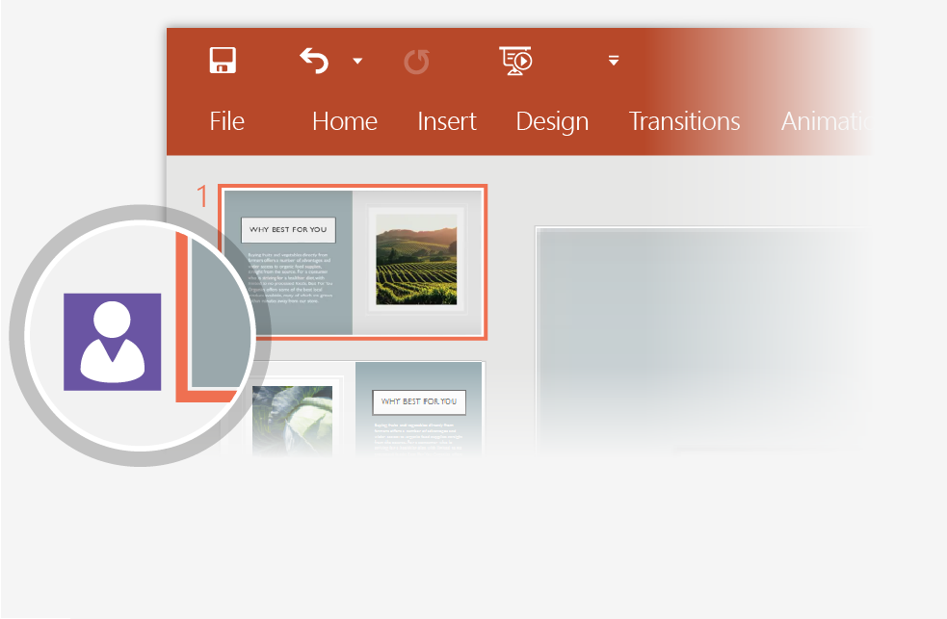
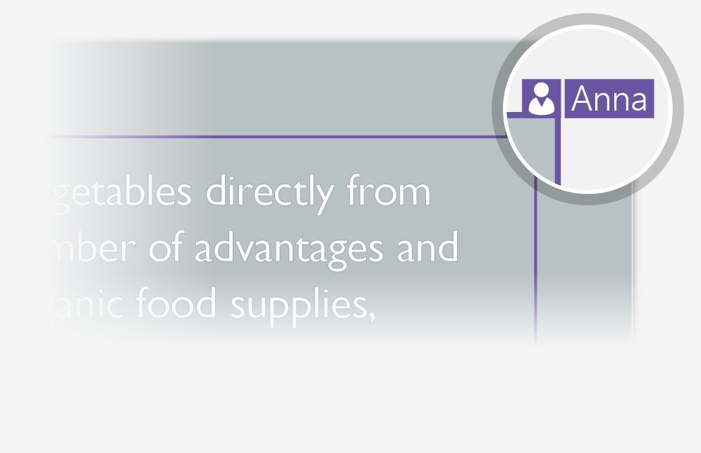
Working together in real time
When you share your presentation with others, you’ll see them working with you at the same time. How it works:
1
Select Share from above the ribbon, or by using short-key Alt-ZS, to invite people to work with you (You can save to the cloud at this point.)
2
When other people are in the presentation, a marker shows who is on which slide…
3
…and the part of the slide they're editing.

Slide 7


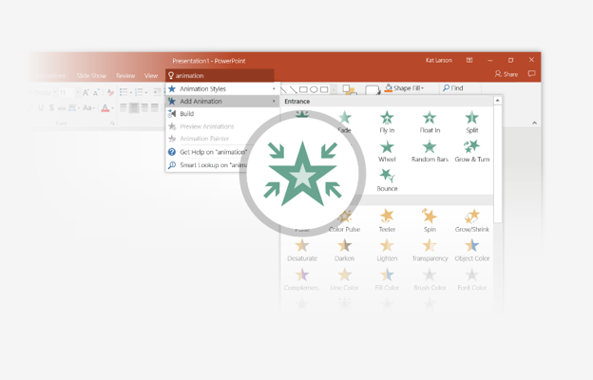
You’re an expert with Tell Me
The Tell Me box finds the right command when you need it, so you can save time and focus on your work. Try it:
SELECT ME
1
Select the Robot picture on the right.
2
Type animation in the Tell Me box, and then choose Add Animation.
3
Choose an animation effect, like Zoom, and watch what happens.

Slide 8
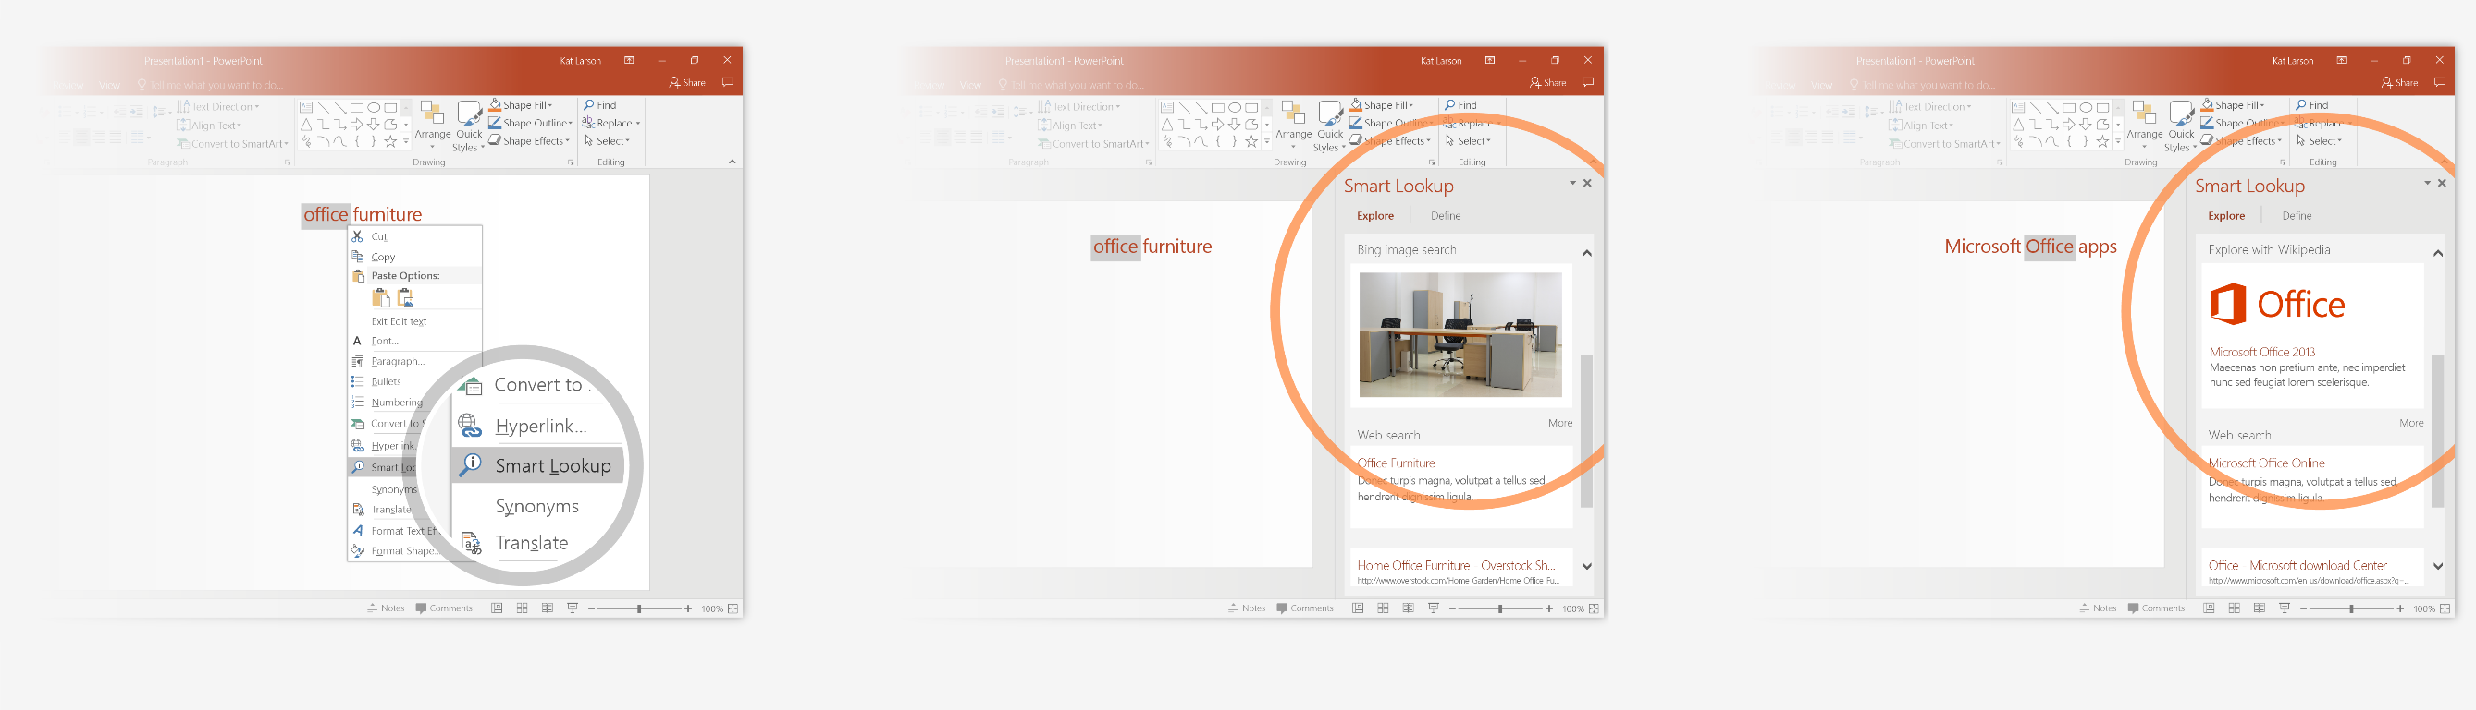
Explore without leaving your slides
Smart Lookup brings research directly in to PowerPoint. Try it:
1
Right-click in the word office in the following phrase: office furniture
2
Choose Smart Lookup, and notice that results are contextual for that phrase, not Microsoft Office apps.
3
Just for fun, try Smart Lookup again by right-clicking in the word Office in Step 2.

Slide 9

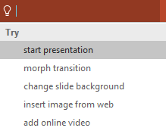

More questions about PowerPoint?
Select the Tell Me button and type what you want to know.
Visit the PowerPoint team blog
Go to free PowerPoint training
SELECT THE ARROW WHEN IN SLIDE SHOW MODE

